Slide 1
My Current Implementation

Slide 2
Parts
System Verilog
  GRU Cell Parallel
  GRU Hidden State Element
  GRU New Gate Element
  GRU Reset Gate Element
  GRU Update Gate Element
Python
  Generate Ground Truth
  Generate Testbench
  Extract Metrics

Slide 3
GRU Cell Parallel
FSM that processes in four stages: reset gates, update gates, new gates, and hidden state
For each stage, go through three stages: initialize, compute, and wait
Parallel processes N elements simultaneously
Cycle through batches until H elements are processed
If H=10 and N=4, processes [0-3], [4-7], then [8-9]

Slide 4
GRU * Element
Each module computes 1 element of a specific equations:
  GRU Hidden State Element
  GRU New Gate Element
  GRU Reset Gate Element
  GRU Update Gate Element
Allows parallelization by generating an amount of modules

Slide 5
Generate Ground Truth
Python: Load same weights and biases as used in the GRU
Python: Run all the test vectors through a GRU implemented with NumPy to create a ground truth
SystemVerilog: Run GRU hardware simulation via Vivado
SystemVerilog: Save simulation outputs to a text file
Python: Convert simulation outputs from fixed point to floating point
Python: Compare simulation outputs to NumPy outputs

Slide 6
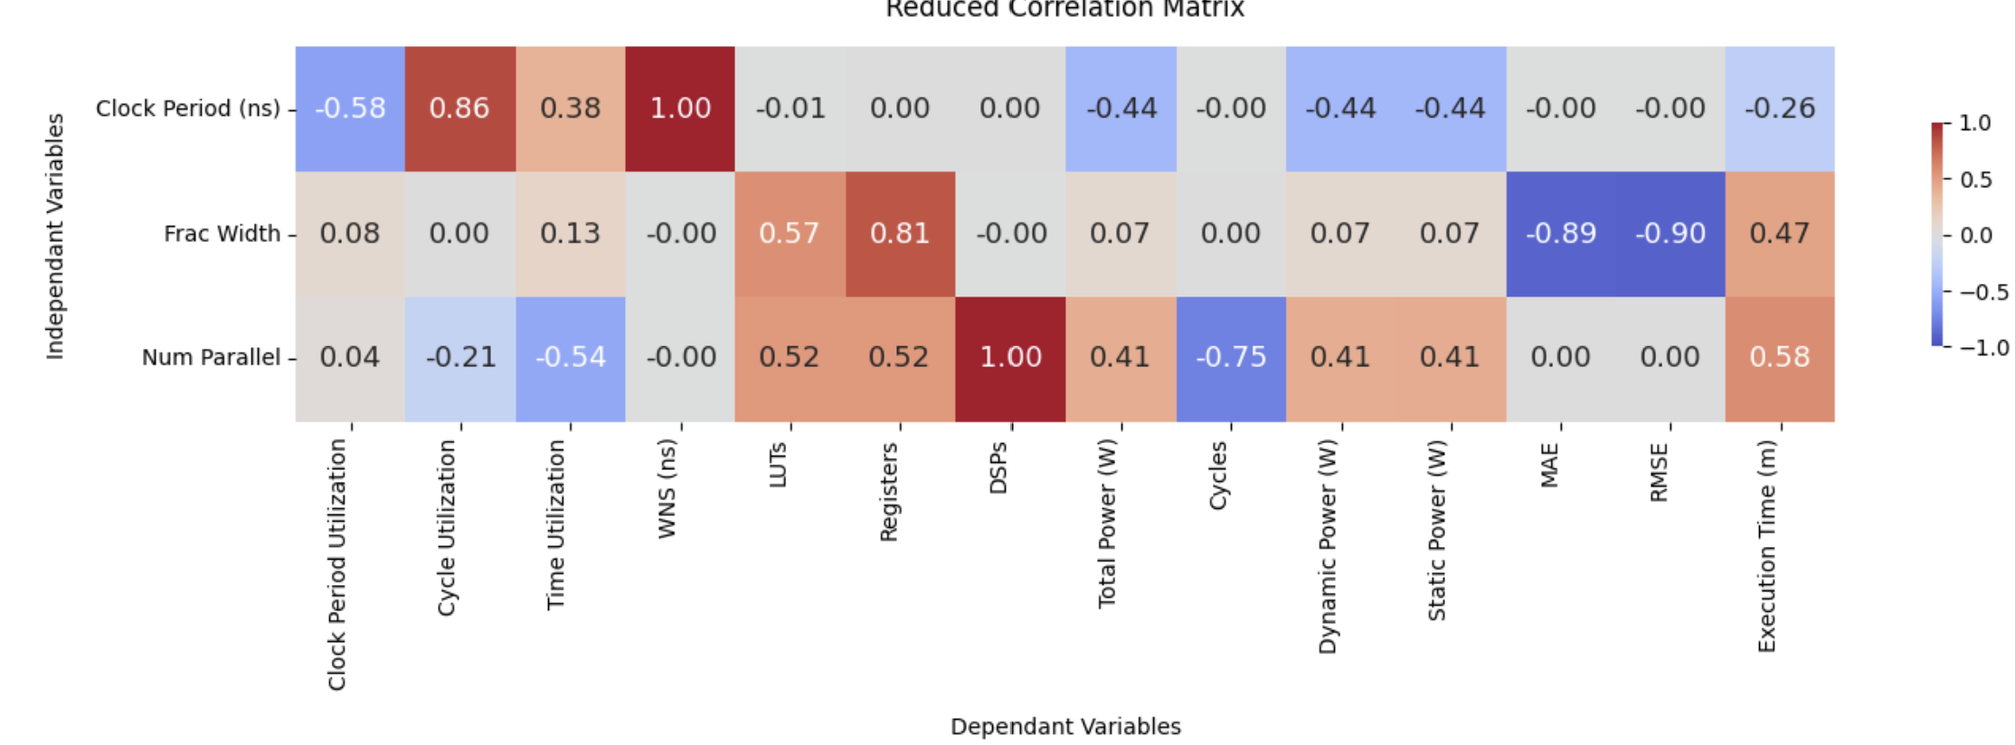
Results

Slide 7
Thermal and Power Things

Slide 8
How Thermal and Power Is Calculated
Thermals are first calculated based on input parameters
Power is calculated based on thermals and input parameters
Parameters:
  Toggle Rate
  Static Probability
  Ambient temperature
  Airflow
  Voltage Used
  Heat sink type
  And many others

Slide 9
Thermal Goals
Researched based on implantable placed right on the brain
For Implanted Cortical BCIs there are limits of a 2°C temperature increase, of 40 mW/cm² heat flux, and of 1.6 mW/g of SAR for devices
  https://www.ncbi.nlm.nih.gov/books/NBK3932/

Slide 10
Simulation Testing Plan

Slide 11
Simulation Testing Plan
Independent Variables
Dependent Variables
Different sized FPGAs: Largest Possible and Test FPGA
Clock Period: Test clock speed vs power usage
Number of Parallel Units: Test hardware area vs speed
BRAM power optimization: Should help power optimization at the cost of more hardware used
Power Characteristics
Timing metrics
Hardware usage
Accuracy

Slide 12
Physical Testing Plan
Choose design from simulation design space
Implement the design so that it can take in data and use the GRU
Run on FPGA to determine
  Power characteristics
  Thermal characteristics

